Slide 1


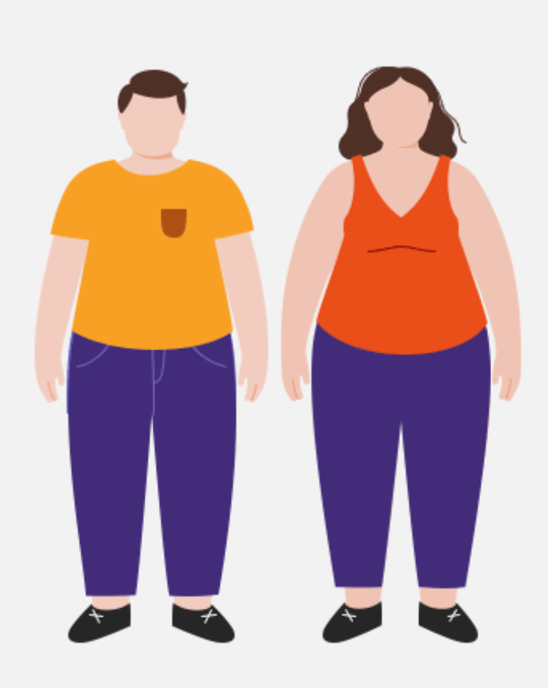
Kenali Pankreas, diabetes mellitus & Faktor risikonya
dr. Ihsanul Rajasa, SpPD
RS Pondok Indah – Bintaro Jaya

Slide 2
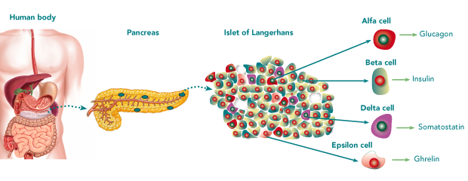
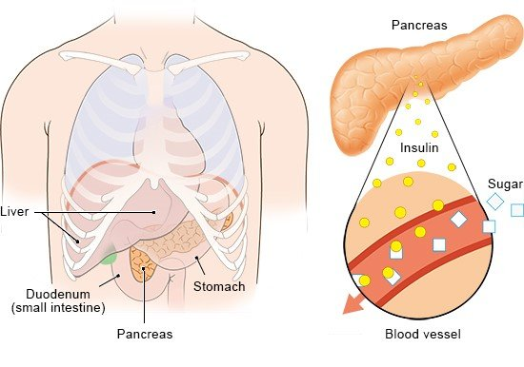
Pancreas
The pancreas is an organ that plays an important role in helping to regulate blood sugar levels
The pancreas produces the hormone insulin
Insufficient prodoction or ressistence could lead into a diabetic state

Slide 3
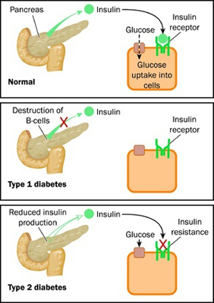
Types of diabetes mellitus
DM tipe 1, DM tipe 2, DM gestasional, DM tipe lain

Slide 4
Diabetes mellitus

Slide 5
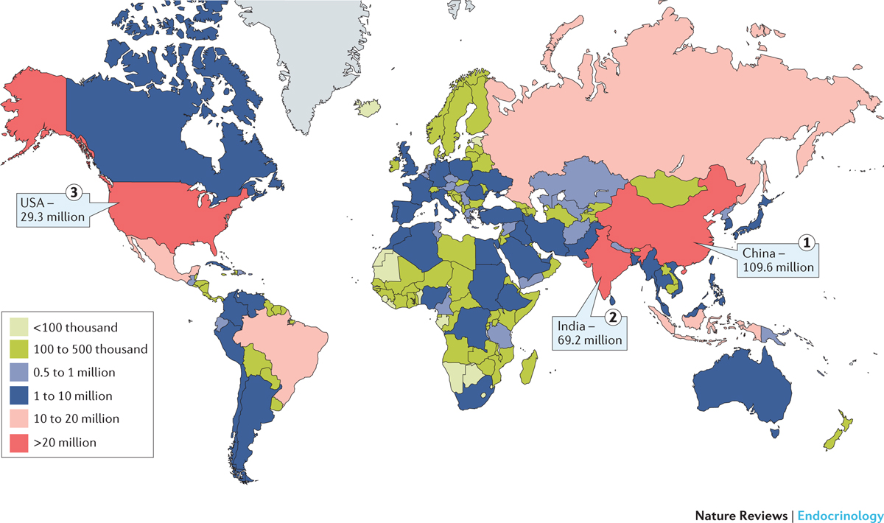

2015
1 out of 10
Indonesian Adults
~ 20 Million People with Diabetes in Indonesia
Zheng et al. Nat. Rev. Endocrinol 2018; 14:88
Notes:
Figure 1 | Estimated total number of adults (20–79 years) living with diabetes mellitus, highlighting the top three countries or territories for number of adults with diabetes mellitus (20–79 years) in 2015. It was estimated that in 2015, 415 million adults aged 20–79 years had diabetes mellitus worldwide, and about 46.5% of them lived in three countries: China, India and the USA. The colour of the country or territory in the map relates to the total number of adults aged 20–79 years living with diabetes mellitus in the area. Figure adapted with permission from Ref. 1, International Diabetes Federation Diabetes Atlas. IDF Diabetes Atlas, 7th edn Brussels, Belgium: International Diabetes Federation, 2015 http://www.diabetesatlas.org.

Slide 6
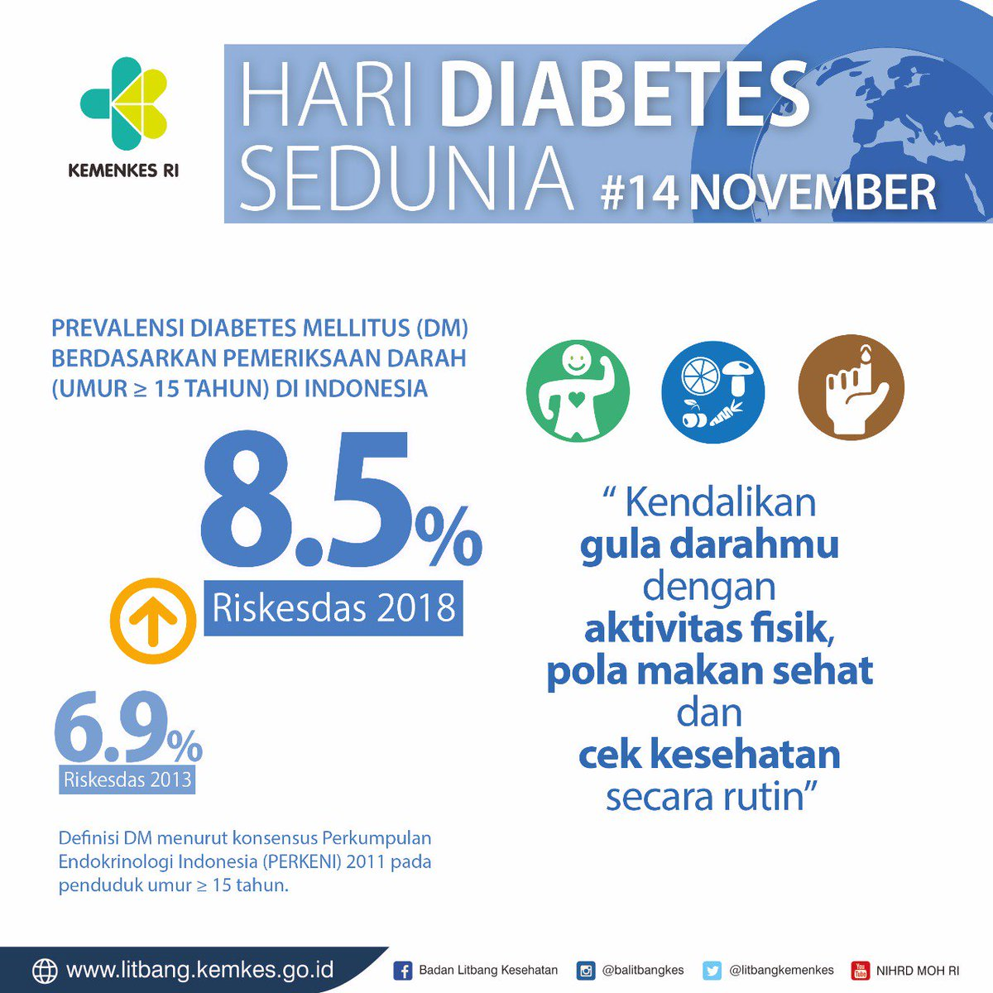
2015
Zheng et al. Nat. Rev. Endocrinol 2018; 14:88
Notes:
Figure 1 | Estimated total number of adults (20–79 years) living with diabetes mellitus, highlighting the top three countries or territories for number of adults with diabetes mellitus (20–79 years) in 2015. It was estimated that in 2015, 415 million adults aged 20–79 years had diabetes mellitus worldwide, and about 46.5% of them lived in three countries: China, India and the USA. The colour of the country or territory in the map relates to the total number of adults aged 20–79 years living with diabetes mellitus in the area. Figure adapted with permission from Ref. 1, International Diabetes Federation Diabetes Atlas. IDF Diabetes Atlas, 7th edn Brussels, Belgium: International Diabetes Federation, 2015 http://www.diabetesatlas.org.

Slide 7
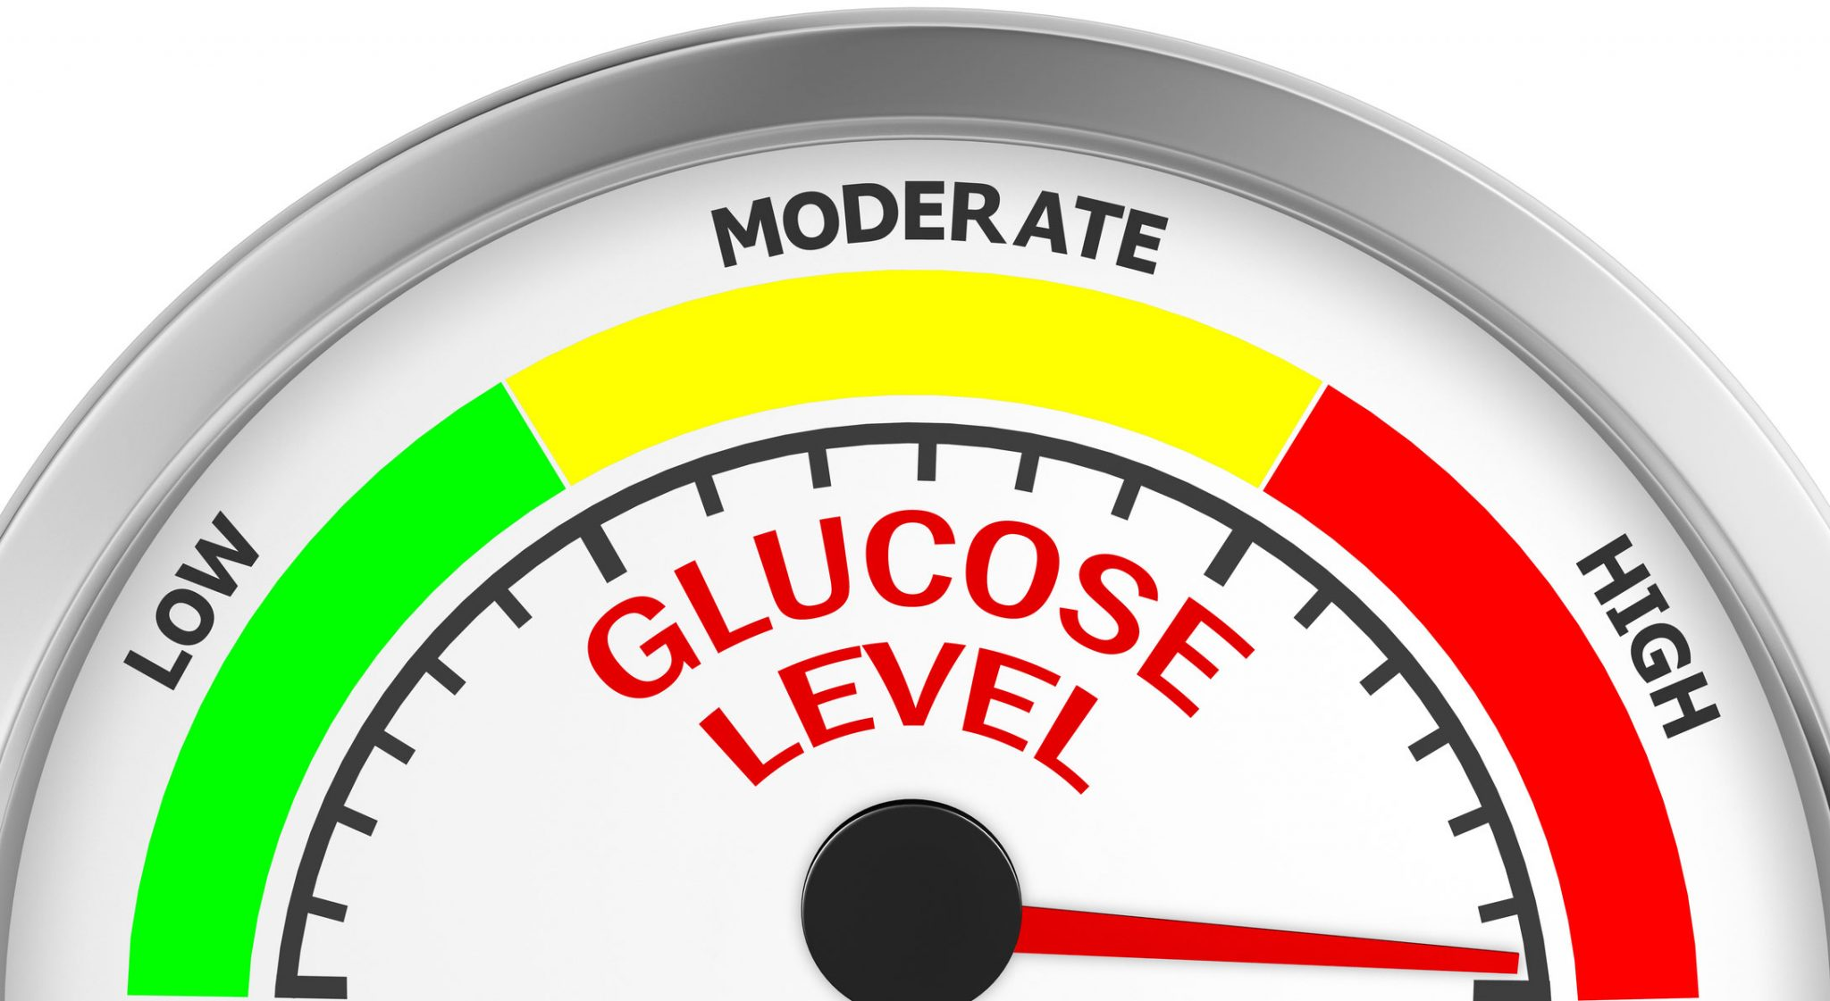
What is diabetes?
A chronic disease in which the pancreas not being able to produce insulin or the body being unable to use insulin effectively which then leads to hyperglycemia, complications, reduced quality of life & increased mortality.
Diabetes mellitus is diagnosed based on high blood glucose (or sugar).
There are 3 potential glucose markers that can be used for diagnosis.
Fasting glucose
Hemoglobin A1c
Two-hour glucose after drinking 75-grams of sugar

Slide 8




Risk Factors for diabetes
Genetics
Environment
Lifestyle
Social Determinants
Family history
Race or ethnicity
Weight gain/OBESITY
Physical inactivity
Poor sleep
Smoking
Acculturation

Slide 9
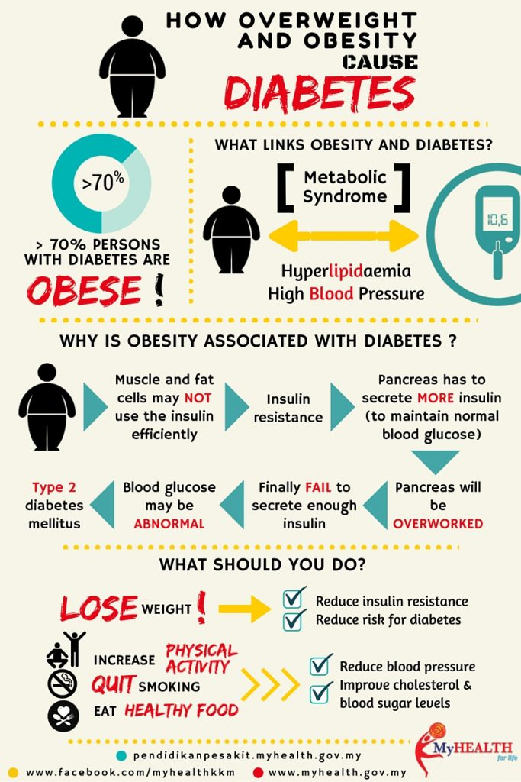
Being overweight increases the chances of developing diabetes.
Body makes enough insulin but the cells in the body have become resistant to action of insulin.

Slide 10
obesity
Obesity : a complex disorder involving an excessive
amount of body fat.
It is not just a cosmetic concern.
It increases the risk of diseases and health problems.

Slide 11
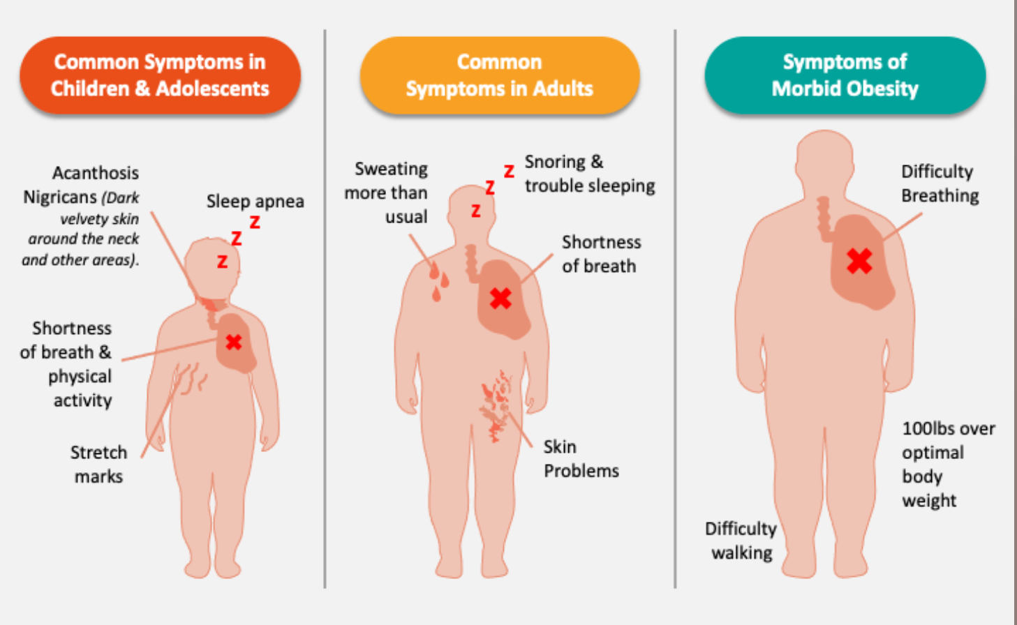
obesity
Signs, Symptoms, and Complications

Slide 12
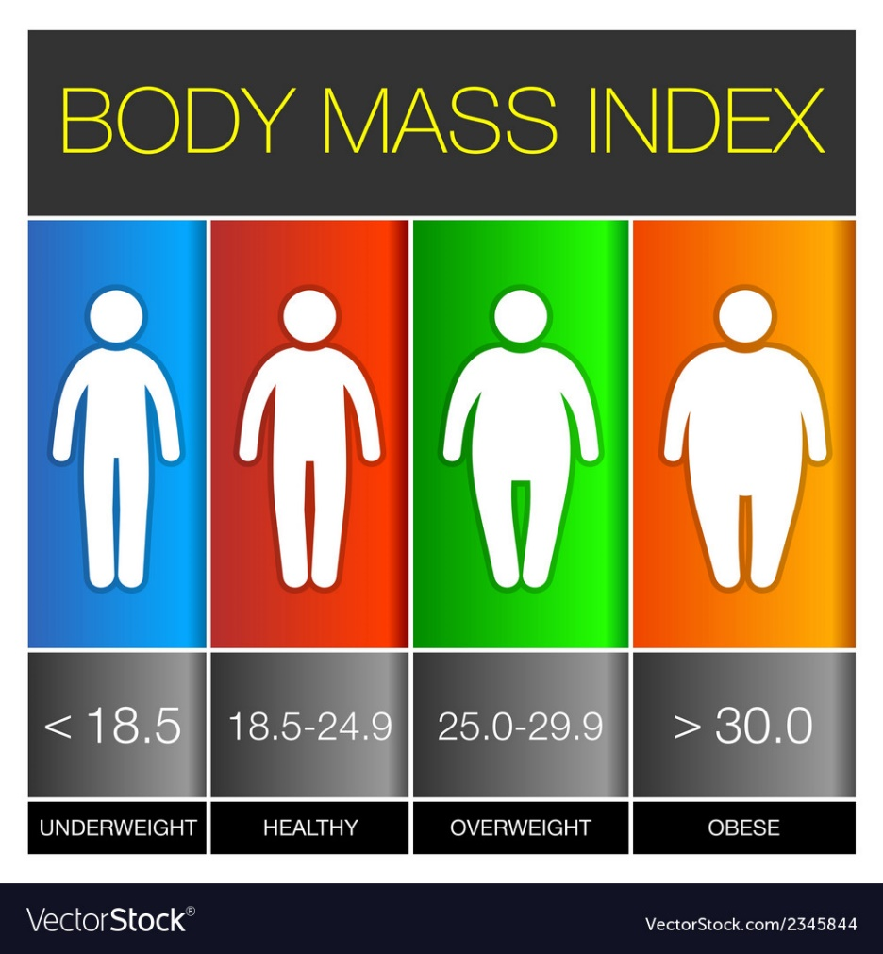
*In Asians,
Overweight: ≥23 kg/m²
Diabetes Care 2015;38:150
2017-2018
<2%
25%
31%
42%
Notes:
Asian BMI

Slide 13

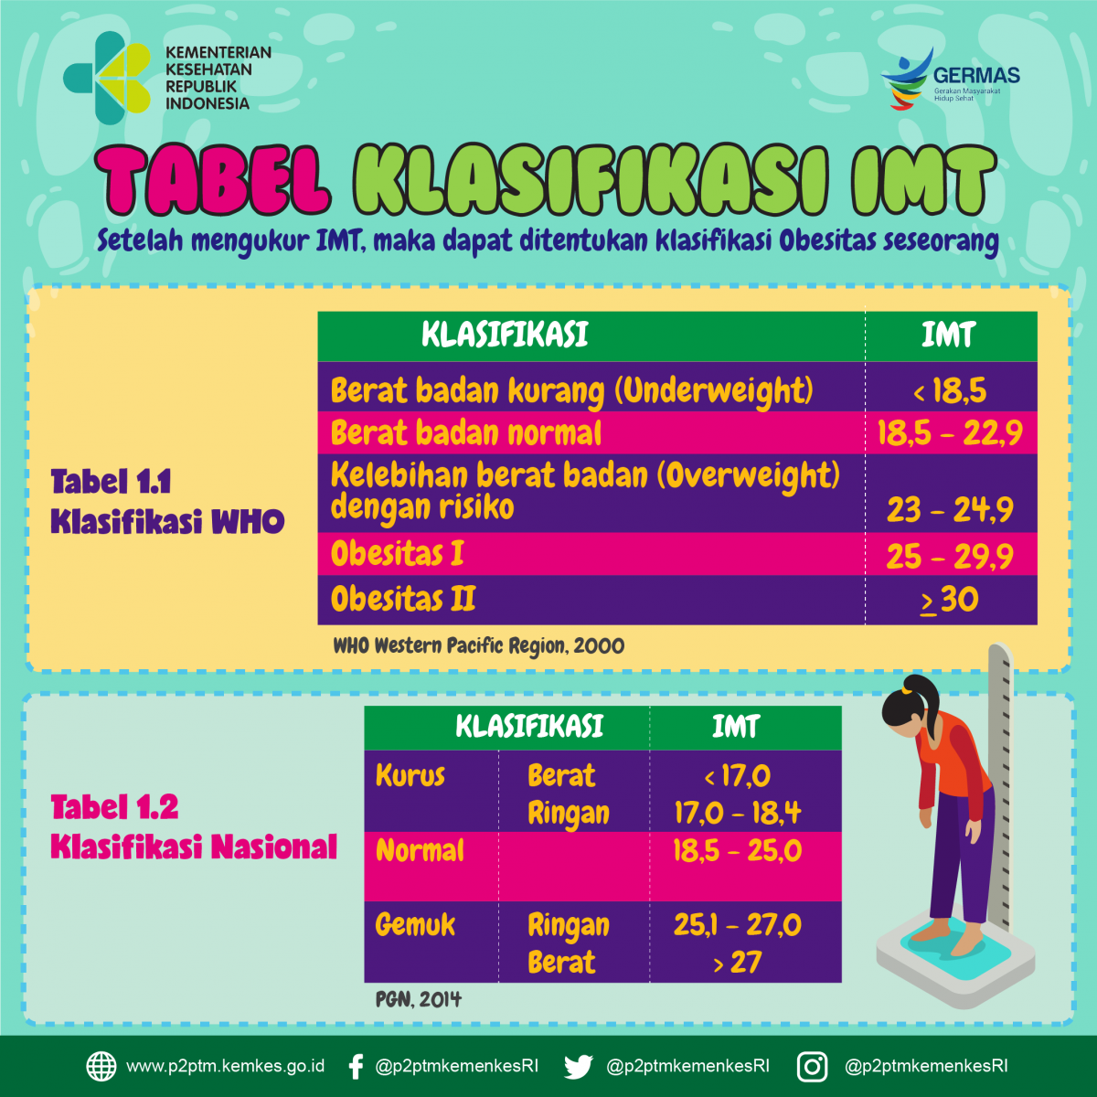

Slide 14
Gejala awal diabetes
1
poliuria
Meningkatknya frekuensi buang air kecil
2
polifagia
Mudah lapar dan makan lebih banyak
3
polidipsi
Sering haus dan cenderung minum air berlebihaan

Slide 15
Gejala umum DIABETES
luka
DIZZINESS
infeksi
Luka sulit sembuh
Mudah lelah
Infeksi pada kulit, kandung kemih
eyesight
tingling
Gangguan penglihatan
Kesemutan/kebas pada tangan/kaki

Slide 16
skrining diabetes mellitus tipe 2
Pemeriksaan penyaring untuk menegakkan diagnosis DM tipe 2 dan Prediabetes → kelompok risiko tinggi
Kelompok dengan BB lebih, IMT >23 kg/m2 disertai dengan satu atau lebih faktor risiko :
Aktivitas fisik kurang
Faktor keturunan DM
Kelompok etnis tertentu
Perempuan dengan Riwayat BBL >4 kg/ Riwayat DM gestasional
Hipertensi (>140/90 mmHg)
HDL <35 mg/dl dan atau trigliserida >250 mg/dl
Wanita dengan sindrom polikistik ovarium
Riwayat prediabetes
Obesitas berat, akantosis nigricans
Riwayat kardiovaskular
T
1

Slide 17
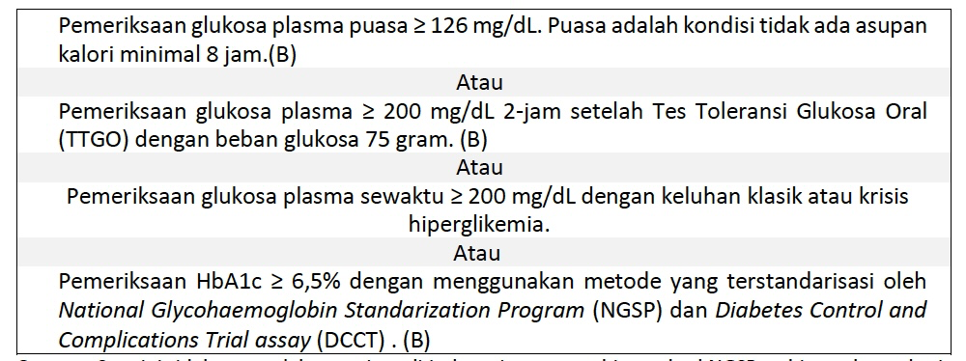
Kriteria diagnosis
Pedoman Pengelolaan dan Pencegahan DM Tipe 2 di Indonesia. Perkeni. 2021

Slide 18
Komplikasi – akibat dari diabetes
Penyakit jantung
Retinopati diabetik
Penyakit jantung, pembuluh darah
Gangguan penglihatan
Fatty liver
Nefropati diabetik
Perlemakan hati
Gangguan ginjal
gastroparese
Neuropati diabetik
Terkait saluran cerna
Gangguan saraf – menyebabkan luka dan amputasi pada kaki

Slide 19
Diabetes Complications in Indonesia
With active case finding
~50%
DiabCare Indonesia 2012, n = 1967

Slide 20
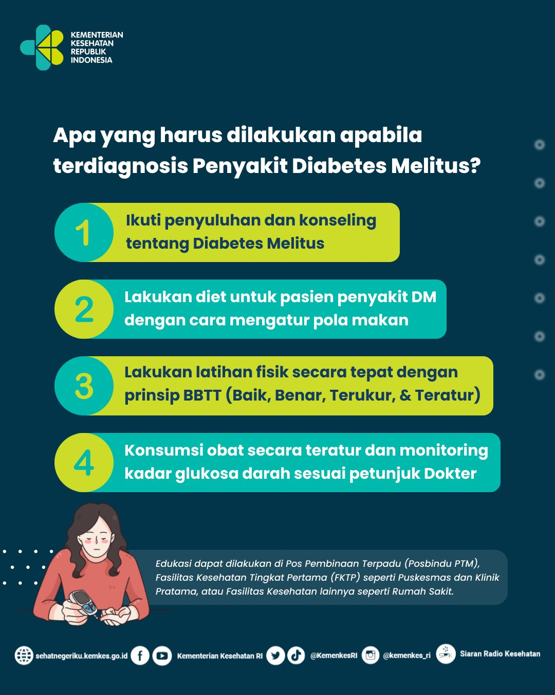

Slide 21
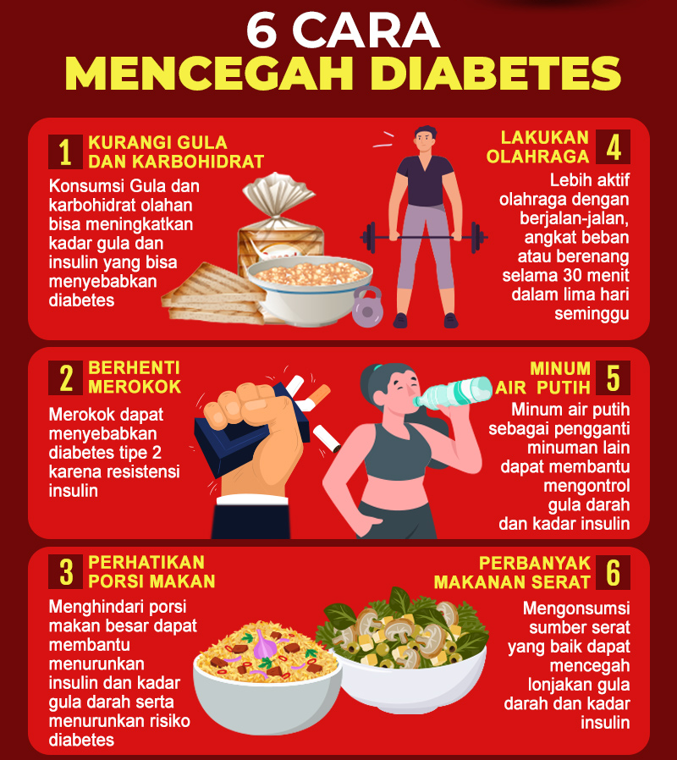

Slide 22
Tujuan tata laksana diabetes
Tujuan jangka pendek : menghilangkan keluhan diabetes melitus, memperbaiki kualitas hidup, mengurangi komplikasi akut.
Tujuan jangka panjang : mencegah dan menghambat progresivitas penyulit gangguan pembuluh darah
Tujuan akhir : menurunkan risiko Tingkat kematian

Slide 23
Pilar tata laksana diabetes
edukasi
Perencanaan makanan
latihan jasmani
farmakologis
Pemeriksaan darah

Slide 24
Aktivitas fisik
Frekuensi : 3-4x/ minggu -- @ 30 menit.
CRIPE : Continuous, Rhytmical, Interval, Progressive, Endurance
Menurunkan berat badan, meningkatkan sensivitivas insulin

Slide 25
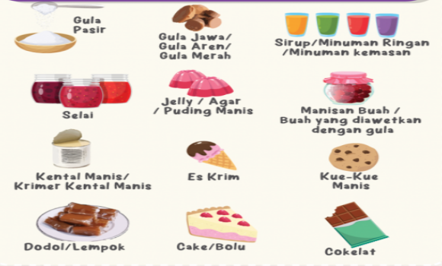


Batasi makanan berikut ini:
Mengandung banyak gula sederhana
Mengandung banyak lemak
Mengandung banyak garam
Jumlah garam dibatasi (garam dapur tidak > 1/4 –1/2 sdt/hari atau < 5 gram garam/hari)

Slide 26
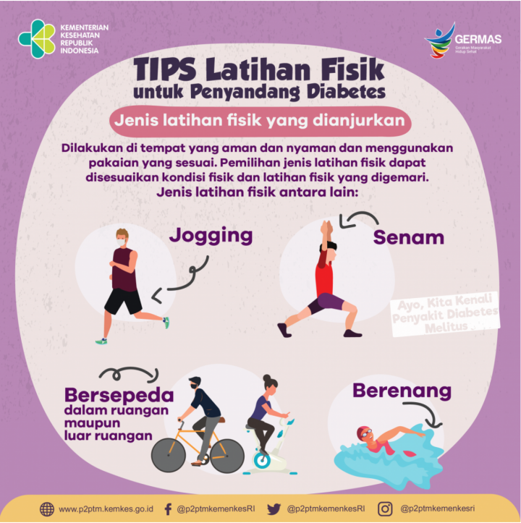
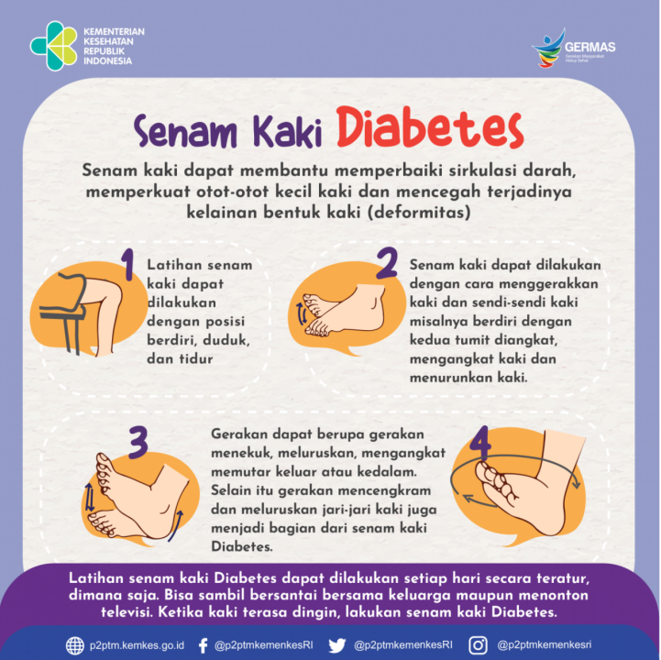

Slide 27
Perilaku hidup sehat untuk menurunkan risiko diabetes melitus

Slide 28
terima kasih

